Slide 1
Energy Trade Law Issues
Presented to:
Petroleum Joint Venture Association
Date: November 28, 2018
Location: The Calgary Petroleum Club
Presented by:
Darrel H. Pearson
Senior Partner & Head, International Trade & Investment Group
Bennett Jones LLP

Slide 2

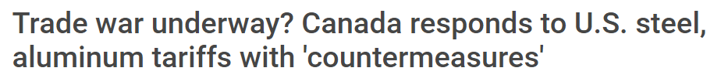
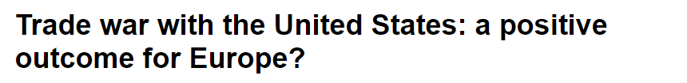
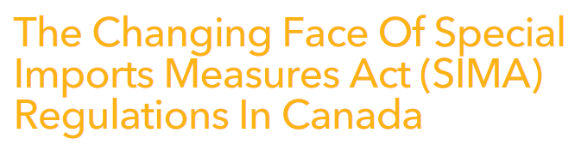


Notes:
Speaking Notes
Procurement, particularly from international sources, is a critical step in any joint venture project.
Trade issues have come to dominate headlines in recent months – volatility, rapid change, and political decision making that creates chaos for supply chain managers.
Hard to keep track of what is going on, let alone look ahead to how you can strategize and manage the risks created by an uncertain global trade environment.
I'm going to explain some of the recent developments in international trade, but through the lens of how they affect your business in the energy law sector.

Slide 3
Presentation Roadmap
Impairment of National Security (U.S. Section 232) Tariffs and Canadian Countermeasure Surtaxes
Steel Safeguard Actions in the Form of Surtaxes/Quotas/Tariff Rate Quotas
Trade remedies (to counter the effects of dumping and subsidization) in the form of Special Import Duties
Renegotiation of NAFTA (USMCA) Outcomes
Comprehensive and Progressive Agreement for Trans-Pacific Partnership (CPTPP) Implementation

Slide 4
What's the Problem?
Costs | Risks
Need certainty about costs of materials | Changes to anticipated ROI
Additional duties unforeseen | Liability for paying for additional duties
Limited volumes without additional duties | Availability and timing of supply
Other market players can affect your duty liability | Need for strategic management to mitigate risk
Notes:
Speaking Notes
Two problems for procurement: COSTS and RISKS. Procurement professionals must be more aware of the impact of import tariffs in assessing the costs of their projects and project returns on investment.
COSTS
Need certainty about costs of materials – some of the changes that we have seen have been announced and then quickly take effect (e.g. provisional safeguards on steel – Oct. 11 to Oct 25 – no grandfathering for material already ordered or on the water)
Additional duties unforeseen – including at time of contract
Provisional steel safeguards system we have – permits a certain volume of imports to come in, and anything above that quota is subject to 25% surtax.
First-come, first-served process for allocating quota means that what other people in the market do, will affect whether or not your goods will be subject to additional duties.
RISKS
Renegotiating free trade agreements, imposing new duties = changes the picture of anticipated ROI
Who pays for the additional costs? Suppliers want to be able to pass the cost downstream, ultimately to project owners.
Availability of supply is jeopardized – trade barriers take certain sources of the table, increase demand for domestic product. Expect backlogs to increase, longer delivery times and supply shortages.
Fundamental message:
Need to be aware of what is going on, and strategically manage your tendering/bidding processes to protect your projects as much as possible.
Cannot rely on suppliers/importers to be aware and manage for you.

Slide 5
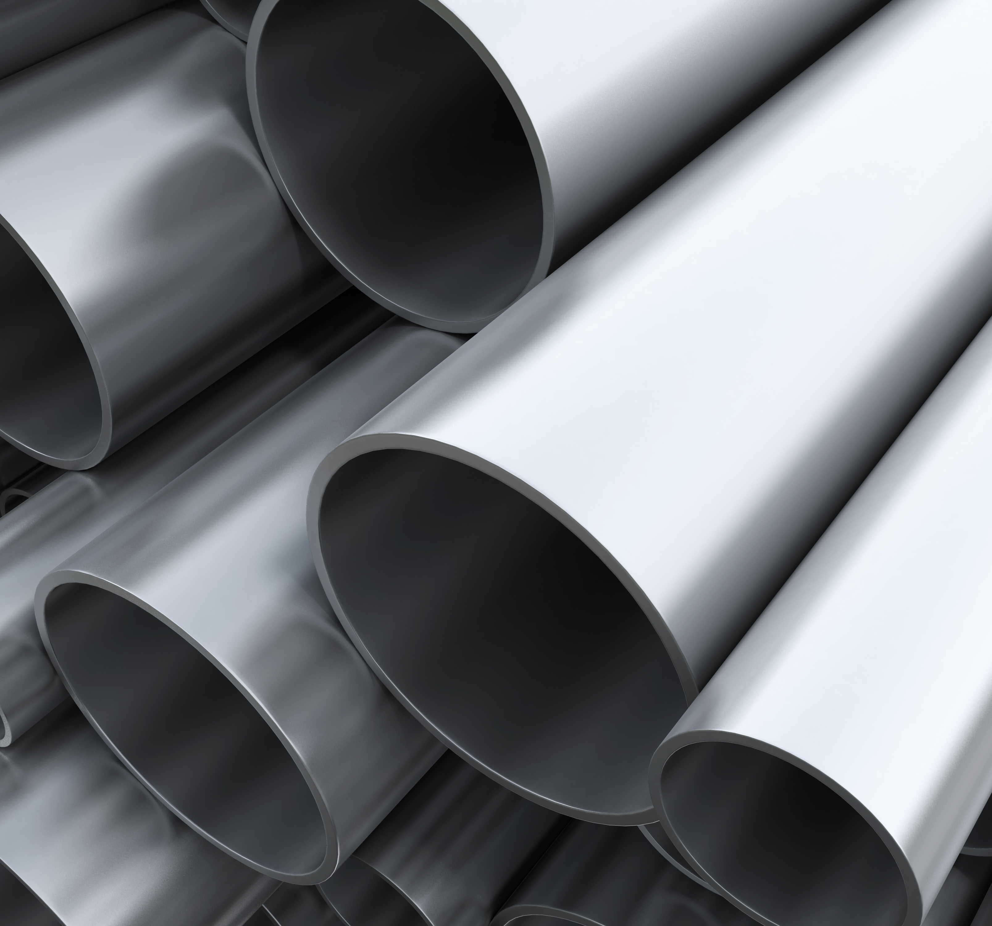
U.S. s. 232 Tariffs on Steel and Aluminum
U.S. Trade Expansion Act: ability to restrict imports that threaten national security
"National security" includes the "general security and welfare of certain industries, beyond those necessary to satisfy national defense requirements, which are critical to minimum operations of the economy and government.“
June 1, 2018: U.S. imposes tariffs—25% on Canadian steel and 10% on Canadian aluminum
July 1: Canada’s countermeasures: 25% surtax on U.S. steel, 10% on U.S. aluminum (and other goods) (amounting to C$16.6 billion per year)
Limited remission now in place (elaborated on later slides)
Notes:
Speaking Notes
Section 232 of the U.S. Trade Expansion Act of 1962 allows the US to restrict imports that threaten national security.
"National security" in the U.S. is a irregular and rarely invoked provision, and its usage includes the "general security and welfare of certain industries, beyond those necessary to satisfy national defense requirements, which are critical to minimum operations of the economy and government."
US had previously introduced the tariffs, but had exempted Canada, Mexico and EU. Revoked the exemption in May.
In response, Canada introduced "countermeasures" in the form of surtaxes (additional duties) on imports of most steel and aluminum, as well as a list of other goods specifically chosen to impact the US economy
25% on steel products
10% on aluminum and other goods
Political solutions?
USMCA does not address s. 232 duties. (Side letter negotiated – 60 day's notice generally + exclusion of autos from future s. 232 up to and beyond current volumes)
Unclear how this will resolve. Some hope to resolve this month, by Nov. 30 when the USMCA is scheduled to be signed at the G20 meetings in Argentina.
Do have limited remission in place to address specific situations of short supply – on application, can have a refund of duties paid for selected products.

Slide 6
U.S. Section 232 Tariffs & Canada’s Countermeasure Surtax (Cont’d)
Strategic Questions to Consider:
Are you correctly tariff classifying your goods? Can your imports be tariff engineered?
Are your goods U.S. “originating”?
Will you or have you exported or re-exported the goods after importation into Canada? (possible duty relief)
Are the goods products of Canada that have been “worked on…” abroad?
Are there special circumstances that justify a general, discretionary remission of duties?
Notes:
Speaking Notes
1. Are you correctly classifying your goods?
The countermeasures are highly targeted, and in many cases identify affected products at the eight-digit tariff item level.
Tariff classification is often a complex exercise, which requires legal analysis informed by the General Rules for the Interpretation of the Harmonized System, Canadian rules, relevant legal notes, and jurisprudence.
If there is a chance that you have incorrectly classified your goods and that an alternative tariff classification is available that is not subject to the surtax measures, consider exploring that possibility.
Moving to a tariff classification that does not attract surtaxes may lead to a change in application of regular customs duties (upward or downward) or may have no effect.
Compare “corrected tariff classification rate of duty” to countermeasure surtax of 10/15%.
Consider importing more or less advanced goods that are tariff classified differentiating and thereby tariff engineer your imports, or change nature of production of imported goods to lose US originating status.
2. Are your goods “U.S. originating”?
The countermeasures are applied to goods that “originate” in the United States as defined by what is known as the “Marking Regulations” (Determination of Country of Origin for the Purposes of Marking Goods (NAFTA Countries) Regulations)
Rules of origin for marking purposes are commonly broader than the rules that determine the origin of goods for preferential tariff purposes. For this reason, some importers may find themselves in the unenviable position of:
(i) not benefiting from NAFTA or other preferential tariff treatment because they do not satisfy the free trade agreement’s rules of origin, but
(ii) still being subject to the countermeasures when importing goods from the U.S. into Canada due to the looser origin requirements of the Marking Regulations.
On the other hand, the fact that the countermeasures are targeted at goods of U.S. marking origin means that not all goods exported from the United States to Canada will be subject to the surtax.
For example, if a U.S. company imports materials into the United States from a foreign supplier and then subsequently ships all or part of those goods to Canada without further processing the goods in the United States in a manner that would change the origin of the goods, these imports into Canada would not be subject to the Canadian countermeasures.
However, because the onus is on the importer to prove that goods are not of U.S. origin for purposes of the countermeasures, it is important to gather adequate documentation to prove the foreign (non-U.S.) originating status of the goods.
This will be particularly important for companies that deal in inputs or materials that are interchangeable (fungible) with U.S. origin goods subject to the countermeasures, in which case appropriate inventory tracking records may be critical to be able to establish exemption of the non-U.S. originating goods.
Or have imported goods produced in a manner that disqualifies NAFTA marking. Duty savings from NAFTA may be less than surtax savings.
E.g. MFN = 3%; surtax = 25%.
3. Will you or have you exported or re-exported the goods after importation into Canada?
The CBSA Duty Relief and Duty Drawback programs are still in effect with respect to goods subject to Canada's countermeasures.
These programs relieve or refund duties and surtaxes on imported goods on the condition that the imported goods, or goods manufactured using the imported goods, are subsequently exported from Canada within 4 years.
The Duty Relief program allows qualified importers to apply in advance for relief from the payment of duties (including surtaxes) at the time of entry, again, as long as the imported goods meet the conditions of relief, including that they are subsequently exported within the required time period.
The Duty Drawback program refunds duties, paid on importation, subsequent to the export/re-export of goods from Canada. Claims may be made up to 4 years after the date of import accounting.
Drawbacks or relief on some exports to the United States are limited by the “lesser of” rule under NAFTA, which requires the importer to be refunded the lesser of duties paid on importation into Canada or subsequent importation into the United States.
4. Are the goods products of Canada that have been “worked on” abroad?
The Canadian Goods Abroad program permits a partial relief from duties for products of Canada that are intended for export from and return to Canada, as long as the goods will be worked on, repaired, or have equipment added abroad, and the work cannot be practicably performed in Canada.
The goods must return within a year of their export from Canada, and the extent of the duty relief is limited to the duties (including surtaxes) payable on the Canadian portion of the value added by the foreign processing.
An application must be made at least three months before the proposed exportation from Canada. (Statutory provision: s. 101(1) of the Customs Tariff)
5. Are there special circumstances that justify a general, discretionary remission of duties?
The granting of a remission order involves both political and legal considerations.
Section 115 of the Customs Tariff permits the discretionary remission of import duties, including surtaxes, if recommended by the Minister of Public Safety and Emergency Preparedness.

Slide 7
Remission for Countermeasures on Certain U.S. Imports – Available as of October 11, 2018
Finance Canada recently issued the remission order for countermeasures on steel and aluminum goods from the U.S.
Under the United States Surtax Remission Order (“Order”), an importer may make a claim for remission of surtaxes on the imports of eligible products as listed in Schedule 1 or 2 of the Order (https://www.fin.gc.ca/access/tt-it/rcsa-rcmaa-eng.asp).
Finance Canada continues to accept applications.
Notes:
Speaking Notes
Finance Canada considers requests for remission, either as relief prior to importation, or to effect a refund after importation, and makes a recommendation to the Minister, who in turn makes a recommendation to the Governor in Council.
Before doing so, the Minister, through his delegate, must conclude that there are exceptional and compelling circumstances that, from a public policy perspective (existential; employment; investment; ROI decrease; debilitates securing financing; profits), outweigh the primary rationale behind the application of duties.
Under subsection 23(3) of the Financial Administration Act, a remission may be “total or partial or conditional or unconditional”. This Act specifies the considerations relevant to an application for remission, i.e., if “the enforcement … is unreasonable or unjust or that it is otherwise in the public interest to remit the tax or penalty.”

Slide 8
Canadian Safeguard Actions
Provisional Safeguards
Global Safeguard Inquiry
Opportunities & Threats for JVs

Slide 9
The Government of Canada imposed provisional safeguards on 7 categories of steel products from October 25, 2018 – May 13, 2019
Notes:
Speaking Notes:
Why safeguards? Trump.
Two aspects: (1) section 232 closes US market to Canadian steel manufacturers and results in retaliation to open up market for CDN manufactures. (2) Diversion risk to the US (the Canadian sieve), recognizing the harm that diversion into Canada may cause to Canadian steel producers

Slide 10
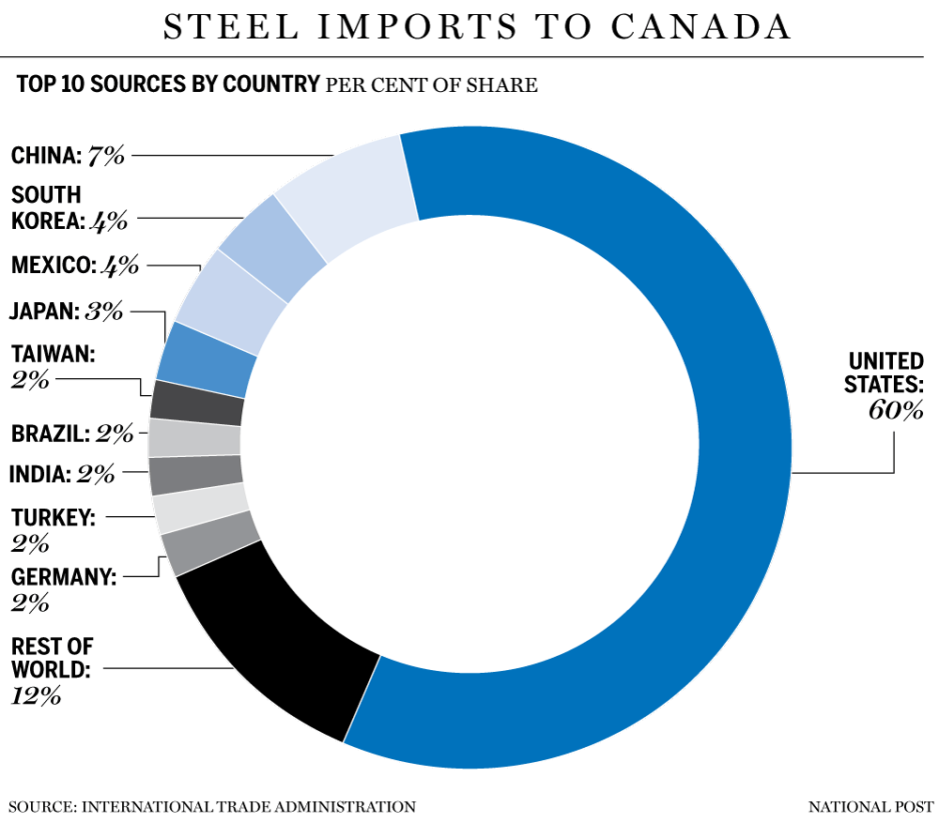
What Are Safeguards?
Exceptional measures intended to temporarily assist domestic producers that have suffered, or are threatened by, serious injury from increased imports of specific goods.
Governed by the WTO Safeguards Agreement
In Canada, measures can take the form of a flat surtax on all imports or a flexible quota system based on import volumes
Provisional safeguards may be imposed provisionally (200 days max.) based on a “critical circumstances” finding
Notes:
Speaking Notes:
The Governor-in-Council (i.e., the Federal Cabinet) has the authority to impose safeguards in Canada.
On a provisional basis and only in the form of a surtax, after a report by the Minister of Finance, in “critical circumstances” for up to 200 days, or following an inquiry by the CITT, for up to 4 years (which can be extended once for a further 4 year period).
The Agreement on Safeguards (“SG Agreement”) sets forth the rules for application of safeguard measures pursuant to Article XIX of GATT 1994. Safeguard measures are defined as “emergency” actions with respect to increased imports of particular products, where such imports have caused or threaten to cause serious injury to the importing Member's domestic industry.
The SG Agreement was negotiated in large part because GATT contracting parties increasingly had been applying a variety of so-called “grey area” measures (bilateral voluntary export restraints, orderly marketing agreements, and similar measures) to limit imports of certain products. [NTD: if you want to elaborate more on the history of the measures]. These measures were not imposed pursuant to Article XIX, and thus were not subject to multilateral discipline through the GATT, and the legality of such measures under the GATT was doubtful. The Agreement now clearly prohibits such measures, and has specific provisions for eliminating those that were in place at the time the WTO Agreement entered into force.
Talk about how the steel quota import has been set based on the historical volume (included the steel imports to Canada – top 10 sources by country from National Post).

Slide 11
Provisional Steel Safeguard Measures – Subject Goods
7 Steel Product Categories Subject to Provisional Safeguards
Energy tubular products
Heavy plate
Hot-rolled sheet
Pre-painted steel
Concrete reinforcing bar
Wire rod
Stainless steel wire
Important: tariff classification (HS Code) is illustrative only. The product definition is determinative.
Notes:
Note: there may be goods under the listed HS number that do not fall within the product definition, or goods that are imported under a HS number that is not listed but that fall within the product definition

Slide 12
Provisional Steel Safeguard Measures - Exclusions
Provisional safeguards apply to all countries except:
  U.S. (subject to retaliatory tariffs due to U.S. 232 action)
  Mexico, except for energy tubular products and wire rod
  Chile
  Israel & beneficiaries of the Canada-Israel Free Trade Agreement
  Countries that qualify for the General Preferential Tariff, except rebar from Vietnam
Notes:
Speaking Notes
There are countries excluded:
United States (already subject to countermeasures)
Mexico (except for energy tubular products and wire rod)
Chile
Israel and other beneficiaries of the Canada-Israel Free Trade Agreement
Most developing countries (i.e. Countries that qualify for the General Preferential Tariff, except rebar imports from Vietnam which are subject to provisional safeguards)

Slide 13
Key Dates in Global Safeguard Action
October 11, 2018 | Government of Canada announces: Imposition of provisional safeguards Safeguards Inquiry by Canadian International Trade Tribunal (“CITT”)
October 25, 2018 | Provisional Safeguards take effect
January 3 to 22, 2019 | CITT hearings in Ottawa
April 3, 2019 | CITT issues report and recommendations on safeguards to the Government of Canada
May 13, 2019 | Provisional Safeguards expire
May 14, 2019 ~ October 24, 2026 | If imposed, “final” safeguards – up to a maximum of 4 years, which can be extended once up to a maximum of an additional 4 years
Notes:
Speaking Notes:
This chart shows the key dates in global safeguard action taking place at the Canadian International Trade Tribunal.

Slide 14
Provisional Steel Safeguard Measures – Access Quantities
Product | Quota for each 50-day Period (tonnes) | Total 200-day Quota (tonnes) | Maximum Share of Total Quota per Country
Energy tubular products | 64,348 | 257,392 | 23% (59,200)
Heavy plate | 12,918 | 51,672 | 23% (11,884)
Hot-rolled sheet | 15,299 | 61,196 | 37% (22,642)
Pre-painted steel | 11,635 | 46,540 | 35% (16,289)
Concrete reinforcing bar | 35,332 | 141,328 | 23% (32,505)
Wire rod | 11,513 | 46,052 | 47% (21,644)
Stainless steel wire | 467 | 1,868 | 25% (467)
Notes:
Once imports surpass the access quantity for the product and period, subsequent imports are subject to a 25% surtax within that 50-day period, until the start of the next 50-day period. The 50-day periods are as follows:
October 25 to December 13, 2018
December 14, 2018 to February 1, 2019
February 2 to March 23, 2019
March 24 to May 12, 2019
Importantly, the Government has also established limits to the total access quantity that can be imported from a single country, by product, over the 200-day period.
E.g.: imports from any individual country of energy tubular products may not exceed 23% of the total 200-day quota amount (59,200.16 tonnes) during the 200-day provisional period. If imports from a single country exceed this “country limit”, the 25% surtax will apply for the remainder of the 200-day provisional period to imports from that country for that product.
Unused access quantity in a given 50-day period carries over into the next 50-day period.

Slide 15
Provisional Steel Safeguard Measures – TRQ
Notes:
Speaking Notes:
This chart shows an example of how
Under this system, the Government has set a total access quantity (tonnes) for each category of steel product imported in the 200-day provisional safeguard period. The access quantity is based on the average volume of imports over a similar period covered by the provisional safeguard in the years 2015-2016, 2016-2017 and 2017-2018. Each access quantity is divided evenly into four 50-day periods, and administered in accordance with the following rules.

Slide 16
Provisional Steel Safeguard Measures – TRQ
Notes:
Under this system, the Government has set a total access quantity (tonnes) for each category of steel product imported in the 200-day provisional safeguard period. The access quantity is based on the average volume of imports over a similar period covered by the provisional safeguard in the years 2015-2016, 2016-2017 and 2017-2018. Each access quantity is divided evenly into four 50-day periods, and administered in accordance with the following rules.

Slide 17
Provisional Steel Safeguard Measures – TRQ
Example:
If the entire 50-day quota limit of 11,635 tonnes of pre-painted steel is used by a single country in the first 50-day period, there will be a total volume of 4,654 tonnes of pre-painted steel available for import tariff-free from that country over the next three 50-day periods before reaching the 200-day country quota limit of 16,289 tonnes.
Notes:
Under this system, the Government has set a total access quantity (tonnes) for each category of steel product imported in the 200-day provisional safeguard period. The access quantity is based on the average volume of imports over a similar period covered by the provisional safeguard in the years 2015-2016, 2016-2017 and 2017-2018. Each access quantity is divided evenly into four 50-day periods, and administered in accordance with the following rules.

Slide 18
Provisional Steel Safeguard Measures – Import Permits
Global Affairs Canada administers the quota of products to be imported surtax-free by issuance of import permits
Only a “Canadian resident” may apply for an import permit
  A customs broker can apply on behalf of a non-resident importer
Import permits issued up to 5 days in advance of the “arrival of the shipment” but are only valid for 14 days from the date of issuance
  Permit may be extended in “exceptional and unforeseen circumstances”

Slide 19
Trends in Canadian AD/CVD
Introduction to SIMA
Normal Value Reviews
No more appeals of dumping determinations?
Possible impact of safeguards on future AD/CVD cases

Slide 20
Special Import Measures Act (SIMA)
The SIMA implements Canada’s obligations under the WTO Anti-Dumping Agreement, and the Agreement on Subsidies and Countervailing Measures
If dumping and/or subsidizing causes or threatens injury to the domestic industry, the CITT may order the imposition of anti-dumping (AD) and/or countervailing duties (CVD)

Slide 21
Key Features of Canadian AD/CVD Regime
Bifurcated responsibilities to impose AD/CVD on goods:
  Canada Border Services Agency (CBSA): determines dumping/subsidization
  CITT: determines injury, product exclusions and conducts public interest hearings
Very short investigations
  90 to 135 days from initiation to imposition of preliminary AD/CVD
  195 to 240 days from initiation to imposition of final AD/CVD
Intended to be a prospective AD/CVD collection regime (as opposed to U.S. retrospective system)

Slide 22









AD/CVD Measures and Changes to SIMA
The majority of current SIMA Measures are imposed on products related to engineering, construction and procurement.
119
87
26
Total cases
Dumping
Countervailing
24
20
23
Carbon and Alloy Steel Line Pipe
Carbon Steel Welded Pipe
Cold-rolled Steel
Concrete Reinforcing Bar
Copper Pipe Fittings
Copper Tube
Fabricated Industrial Steel Components
Fasteners
Gypsum Board
Hollow Structural Sections
Large Line Pipe
Liquid Dielectric Transformers
Oil Country Tubular Goods
Piling Pipe
Pup Joints
Seamless Casing
Silicon Metal
Steel Grating
Steel Plate
Sucker Rods
9
3
Dumping & Countervailing
4
1
4
1
6
4
1
Subsidy
Notes:
The majority of current SIMA Measures are imposed on products related to engineering, construction and procurement.
Dumping only: 87 (China – 24; Korea – 9; Turkey, U.S. and Chinese Taipei each 4)
Countervailing only: 26 (China – 20; India – 3; EU – 1; Oman – 1 and Pakistan – 1)
Dumping & countervailing together: 23
Subsidy/subsidizing: 6 (1 subsidy case from Korea, which is also a dumping case)
Total cases: 119

Slide 23
Current SIMA Measures in Force
The majority of current SIMA Measures are imposed on products related to engineering, construction and procurement.
Dumping only: 87 (China – 24; Korea – 9; Turkey, U.S. and Chinese Taipei each 4)
Countervailing only: 26 (China – 20; India – 3; EU – 1; Oman – 1 and Pakistan – 1)
Dumping & countervailing together: 23
Subsidy/subsidizing: 6
Total cases: 119
Source: Canada Border Services Agency, “Measures in Force”: https://www.cbsa-asfc.gc.ca/sima-lmsi/mif-mev-eng.html
Notes:
Impact on construction industry by list of cases (subject goods).

Slide 24
Current SIMA Measures in Force
Carbon and Alloy Steel Line Pipe: Dumping & Countervailing (China)
Carbon and Alloy Steel Line Pipe 2: Dumping (Republic of Korea)
Carbon Steel Welded Pipe (CSWP 1): Dumping & Countervailing (China)
Carbon Steel Welded Pipe 2 (CSWP 2): Dumping (Chinese Taipei, India, Oman, Republic of Korea, Thailand and United Arab Emirates); Countervailing (India)
Carbon Steel Welded Pipe 3 (CSWP 3): Dumping (Pakistan, Philippines, Turkey, Vietnam)
Notes:
Here is the list of the current SIMA Measures in Force, of the subject goods that would be relevant to the EPC companies (organized in the alphabetical order). Source: CBSA, Import Statistics for SIMA Measures in Force, https://www.cbsa-asfc.gc.ca/sima-lmsi/mif-mev-stats-eng.html.

Slide 25
Current SIMA Measures in Force (Cont’d)
Cold-rolled Steel: Dumping and Subsidy (China, South Korea, Vietnam)
Concrete Reinforcing Bar: Dumping (China, Republic of Korea, Turkey); Countervailing (China)
Concrete Reinforcing Bar 2: Dumping (Belarus, Chinese Taipei, Hong Kong, Japan, Portugal and Spain)
Copper Pipe Fittings: Dumping (China, Republic of Korea and United States); Countervailing (China)
Copper Pipe Fittings 2: Dumping and Subsidizing (Vietnam)

Slide 26
Current SIMA Measures in Force (Cont’d)
Copper Tube: Dumping (Brazil, China, Greece, Mexico and Republic of Korea); Countervailing (China)
Fabricated Industrial Steel Components: Dumping (China, Korea and Spain) & Countervailing (China)
Fasteners: Dumping (China and Chinese Taipei); Countervailing (China)
Flat Hot-Rolled Carbon and Alloy Steel Sheet and Strips: Dumping (Brazil, China and Ukraine); Countervailing (India)

Slide 27
Current SIMA Measures in Force (Cont’d)
Gypsum Board: Dumping (United States of America)
Hollow Structural Sections: Dumping (Republic of Korea and Turkey)
Large Line Pipe: Dumping (China and Japan) & Countervailing (China)
Liquid Dielectric Transformers: Dumping (Republic of Korea)
Oil Country Tubular Goods (OCTG 1): Dumping & Countervailing (China)
Oil Country Tubular Goods 2 (OCTG 2): Dumping (Chinese Taipei, India, Indonesia, Philippines, Republic of Korea, Thailand, Turkey, Ukraine and Vietnam

Slide 28
Current SIMA Measures in Force (Cont’d)
Piling Pipe: Dumping & Countervailing (China)
Pup Joints: Dumping & Countervailing (China)
Seamless Casing: Dumping & Countervailing (China)
Silicon Metal: Dumping & Countervailing (China)
Steel Grating: Dumping & Countervailing (China)
Steel Plate 3: Dumping (China)
Steel Plate 5: Dumping (Bulgaria, Czech Republic and Romania)
Steel Plate 6: Dumping (Ukraine)
Steel Plate 7: Dumping (Brazil, Denmark, Indonesia, Italy, Japan and the Republic of Korea)
Sucker Rods: Dumping and Subsidy (China)

Slide 29
Normal Value Reviews and prospective AD liability
Under Canada’s prospective regime, AD rates (fixed normal values and/or the “all others rate”) are set at the original investigation
  Exporters are directed to notify the CBSA of “significant changes” to their costs/domestic selling prices
The AD rates are periodically updated through “re-investigations”, which result in new fixed normal values/all others rate applied from the conclusion of the re-investigation
  The CBSA does not apply the re-investigation results to past imports unless the exporter failed to notify the CBSA of a “significant change”
  Re-investigations are open to all exporters from the named country, even though that elected not to participate

Slide 30
Company-Specific Normal Value & Export Price Reviews
In June 2018, the CBSA introduced a new process – the Normal Value Review
  Process and procedure is identical to a re-investigation
  Difference is that it only applies to a single exporter who has received fixed normal values
  Rationale is enforcement – ensures that most up to date information is used to calculate AD rates
Notes:
Company-specific

Slide 31
No Ability to Appeal a Final Determination?
At the close of an investigation, the CBSA issues a final determination of dumping (“FD”)
  The FD determines, for each exporter, the rates used to determine AD liability on future imports
  If the margin of dumping is “insignificant” (less than 2%) the investigation is terminated and no AD is imposed
SIMA provides right to appeal final determination to Federal Court of Appeal

Slide 32
SeAH v. EVRAZ
In 2017, the Federal Court of Appeal stated that a exporter can not appeal a final determination unless it could prove that the margin of dumping is “insignificant” (less than 2%)
The Federal Court has held that re-investigations (and thus normal value reviews) cannot be appealed
The only way to challenge the results of a final determination/re-investigation/normal value review is to “import and appeal”
  I.e. the Importer must pay the AD and engage in a lengthy administrative process for a refund

Slide 33
SeAH v. EVRAZ (Cont’d)
Does Canada now have a quasi-retrospective system like the US?
While the Supreme Court of Canada reverse this state of affairs?
  Nippon Steel et al. v. EVRAZ et al. – application for leave to appeal before the Supreme Court of Canada
Notes:
Indicate that the significance threshold as it presently stands applies to limit review sougyht by both the canadian importer (Exporter and project owner) as well as domestic industry.

Slide 34
Possible impact of safeguards on future AD/CVD cases
Effect of TRQ and 25% surtax on pricing in Canada
Short supply
Niche products

Slide 35


U.S.-Mexico-Canada Agreement
USMCA or NAFTA 2.0

Slide 36
NAFTA Renegotiations - USMCA
NAFTA: trilateral trade agreement came into force on Jan. 1, 1994
September 30, 2018: the U.S., Mexico and Canada have concluded the new NAFTA called the “United States-Mexico-Canada Agreement” (USMCA)
The USMCA will not come into force until it is ratified (early 2019)
The announcement should temper the uncertainty that hung over access for Canadian goods and services to the U.S. market and improve business confidence in Canada.
Notes:
Speaking Notes:
The first round of NAFTA renegotiations began in August 2017. 13 months later, the U.S. Mexico and Canada reached an agreement called USMCA.

Slide 37
USMCA – National Security (Section 232) Tariffs
The USMCA does not address future section 232 U.S. tariffs on aluminum and steel, other than a notice requirement in a side letter for Canada Mexico (described as the “fatal flaw” for Canada).
“It may have been a better strategic move to negotiate Section 232 separately, eliminating a Canadian ‘ask’ from the negotiations so as not to add to the U.S. leverage, but the risks of continued threats of 10 or 25 per cent are too large”
Darrel Pearson, Financial Post, September 20, 2018
Notes:
Speaking Notes
We just saw how Canada implemented countermeasure surtax on steel, aluminum and sundry other products as retaliatory measures against the U.S. section 232 tariffs. During the negotiation, the Canadian government kept section 232 discussion separate from the NAFTA renegotiations. Minister of Foreign Affairs Chrystia Freeland: “The 232 tariffs and the NAFTA negotiations are entirely separate. 232 is a national-security consideration; it is not part of a trade negotiation. It ought not to be.” Source: “Steel makers seek removal of U.S. tariffs in NAFTA” – Globe and Mail article on September 6, 2018:
.

Slide 38
USMCA – National Security (Section 232) Tariffs (Cont’d)
In the Section 232 side letter:
The U.S. agreed that if it imposes future s. 232 measures, they won’t apply against Canada or Mexico until 60 days after they are notified.
During the notice period, the U.S. and Canada (or Mexico) shall "seek to negotiate an appropriate outcome".
Could end up being the most important weakness of the new NAFTA.
Notes:
Speaking Notes:
The side letters are essentially a notice requirement.
Finance Minister Bill Morneau: the government is still negotiating with U.S. officials in hopes of seeing the steel / aluminum duties lifted.
Reminder: other 232 (auto above quota or uranium) → other countermeasure against the US
Once the 60-day time limit runs out, the exemption expires and the tariffs would apply to Canadian and/or Mexican goods if no agreement is reached.
The side letters expressly permit Canada and Mexico to take retaliatory measures of "equivalent commercial effect" if the U.S. section 232 action is "inconsistent" with the USMCA or the WTO (or the NAFTA, if applicable).
Canada and Mexico also retain the ability to challenge a section 232 measure at the WTO. Notwithstanding, the USMCA does nothing to delegitimize the application of s. 232 measures against the close trading partners of the U.S., and does not answer the question of how a free-trading partner may represent an security risk for the U.S.
With respect to the U.S. sources’ speculation that the section 232 tariffs would be replaced by quotas.

Slide 39
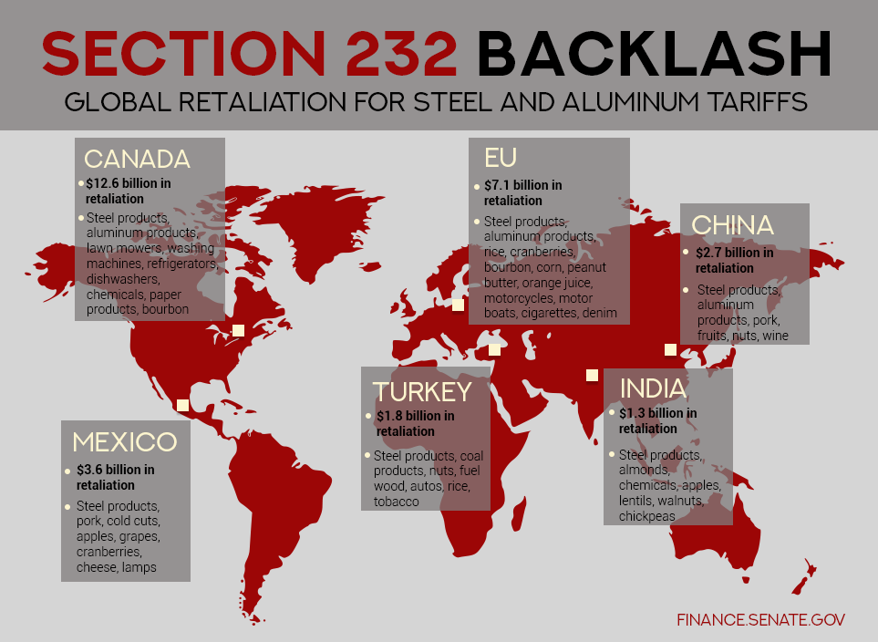
USMCA – National Security (Section 232) Tariffs (Cont’d)
Canada’s response to steel quota by the US?
  Maintain or disband Countermeasures
  Replace Countermeasure with safeguard solution
  Negotiated Countermeasures
Notes:
Speaking Notes:
U.S. sources speculate that the Section 232 tariffs would be replaced by quotas, with allocation levels still being discussed. Canada so far rejects this approach.
Canadian safeguard against actions are another arrow in Canada’s quiver to defend allegation of Canada being a security risk due to leakage of foreign imports through Canada to US.
If US applies quotas reducing Canadian steel exports and US exports to Canada increases, Canada may implement additional countermeasures.
See the map: this is the breakdown of the global retaliation for steel and aluminum tariffs (from Canada, EU, China, India, Turkey and Mexico) (prepared by the U.S. Senate Committee on Finance in June 2018).

Slide 40
USMCA – Dispute Settlement for Trade Remedies
The USMCA preserves the binational panel "dispute settlement mechanism" presently found in NAFTA Chapter 19, and confers on all parties the right to challenge each other’s anti-dumping and countervailing duty decisions before an independent, expert panel. Chapter 19 became a red line issue for Canada during the negotiations and was hotly contested by U.S. negotiators.
Notes:
Speaking Notes:
USMCA maintains the NAFTA state-to-state mechanism for most disputes arising under the agreement. It also retains the binational dispute settlement mechanism to review trade remedy disputes.
Retention of the mechanism is viewed by many as a political win for Canada. It has been used to adjudicate important trade disputes involving softwood lumber, apples and pork. Historically, Canada has used Chapter 19 dispute settlement panels to challenge U.S. trade remedy decisions, including the softwood lumber case.
My own perspective: better to have sought complete exemption from s. 232 application.

Slide 41
USMCA – Dispute Settlement for Investors
The Investment-State Dispute Settlement (ISDS) mechanism that wa available for Chapter 11 (investment) violations is not applicable to U.S.-CAN disputes; U.S.-MEX disputes restricted
Notes:
Speaking Notes:
However, USMCA would: eliminate investor-state dispute settlement (ISDS) for Canada after the termination of NAFTA; maintain ISDS only between the United States and Mexico for claimants regarding government contracts in the oil, natural gas, power generation, infrastructure, and telecommunications sectors; and maintain U.S.-Mexico ISDS in other sectors provided the claimant exhausts national remedies first.

Slide 42
USMCA – Energy
Provisions governing trade in energy will be found across the modernized agreement.
includes disciplines and provisions in the areas of national treatment and market access, rules of origin, customs and trade facilitation, and cross-border trade in services and investment.
Importantly, the agreement no longer includes what was referred to as the energy “proportionality clause”.
Notes:
Speaking Notes
Unlike the original NAFTA, which had a chapter on energy, the new agreement does not have a specific chapter pertaining to energy, but has other provisions throughout the agreement that are relevant to energy.
Article 605 of the NAFTA allows Canada to restrict the export to the United States of an "energy or basic petrochemical good" but only to a certain extent based on recent export levels (a proportionality requirement). Hypothetically, if the production quota operates in effect as a limitation on exports to the United States, the US government might consider launching a complaint under the NAFTA.
However, this claim is only possible under the NAFTA because this restriction is not included in the USMCA, and it has not been grandfathered.

Slide 43
USMCA – Global Safeguards
With respect to global safeguards, the USMCA is almost identical to the existing global safeguards exclusion under NAFTA Ch 8.
Continues to provide preferential treatment to imports from the other parties.
Safeguard - preferential test for US and Mexico under Canadian law (Customs Tariff, section 59(b)): requires “important contribution to serious injury or threat of serious injury to domestic producers of like or directly competitive goods”.
Notes:
Speaking Notes:
Customs Tariff test for USMCA and other FTAs.
Currently in Customs Tariff section 59(b):
“in the case of goods imported from a NAFTA country, the quantity of those goods, alone or, in exceptional circumstances, together with the quantity of goods of the same kind imported from each other NAFTA country, contributes importantly to serious injury or threat of serious injury to domestic producers of like or directly competitive goods”.
Important reason why US and most Mexican categories of steel are exempt from ongoing safeguard inquiry (for now)
Discuss treatment of US and Mexico by Minister Morneau on steel safeguard provisional surtaxes and CITT inquiry
The United States, which is already subject to retaliatory tariffs on steel and other products;
Mexico, except for energy tubular products and wire rod which are subject to provisional safeguards;
Chile;
Israel and other beneficiaries of the Canada-Israel Free Trade Agreement; and
Countries that qualify for the General Preferential Tariff (PDF from Canada Border Services Agency), except rebar imports from Vietnam which are subject to provisional safeguards.

Slide 44
USMCA – No Canada-U.S. Government Procurement
Notably, USMCA has no government procurement provisions gathering access (Buy America)
This omission is viewed as Canada’s loss in the negotiation
  This was a significant focus of the Canada-EU Comprehensive Economic and Trade Agreement (CETA)
Canada and the U.S. will retain access to each other’s procurement markets through the WTO Agreement on Government Procurement (including at the sub-federal level).
The Canada-Mexican procurement obligations will be provided under the Comprehensive and Progressive Agreement for Trans-Pacific Partnership (CPTPP).
Notes:
Speaking Notes:
NAFTA contained a GP chapter, which set standards and parameters for government purchases of goods and services and opportunities for firms of each nation to bid on certain contracts for specified government agencies above a set monetary threshold on a reciprocal basis.
The USMCA GP chapter only applies to U.S.-Mexico procurement, while Canada remains covered by the more recent and comprehensive WTO Government Procurement Agreement (GPA). However, the monetary threshold for the GPA is higher at $180,000 as compared to NAFTA’s $25,000, thus reducing Canada’s opportunities to bid on U.S. contracts.
Unfortunately from the Canadian perspective, Canada sought, but failed, to remove “Buy American” and open up subnational procurement in the United States.
Note: public procurement opportunities available to Canadian companies viewed as an attractive opportunity. Canadian firms – for example, in construction, consulting and engineering – can bid alongside local firms for work on public projects in CPTPP countries.

Slide 45
So What Can You Do?
Contractual Clauses
  Who will be liable for taxes/tariffs/duties/penalties/interest?
  Does the supplier have any obligation to be fair in how it allocates its quota under the provisional safeguards?
  Clauses to allow a purchaser to reduce or cancel an order if surtaxes apply or to require the seller to guarantee supply?
AD/CVD Duties are Different from Safeguards
  Cannot make the vendor/exporter responsible for anti-dumping duties
  Can take precautionary steps if responsible for duties (e.g., check quotes)

Slide 46
Contracts: Allocations of Liabilities and Other Key Terms
Consider who will be liable for taxes/tariffs/duties/penalties/interest
Distinction between anti-dumping / countervailing duties, and the safeguard surtax → cannot make vendor / exporter responsible for ADD.

Slide 47
Contracts: Allocations of Liabilities and Other Key Terms
E.g. of allocating liability to the buyer:
“Buyer agrees to pay any and all new taxes/tariffs/duties assessed on this order from September 1, 2018 through to the time of arrival at Calgary, Canada. This includes, but is not limited to, trade restrictive tariff or non-tariff countermeasures, anti-dumping or countervailing duties, and safeguard measures on steel products in the form of a surtax, quota or tariff rate quota.”

Slide 48
Contracts: Allocations of Liabilities and Other Key Terms
Similarly, seller protection against any liability:
“The Seller shall have no liability for any loss of profit arising under or in connection with the Purchased Goods in relation to the imposition by the Government of Canada of safeguard measures, trade remedies or any other trade restrictive countermeasures”.

Slide 49
Contracts: Allocations of Liabilities and Other Key Terms (Cont’d)
E.g. of the Seller ensuring supply of the product under the safeguard quota:
“The Buyer shall accept such reduced quantity of the Purchased Goods and the Seller shall have no liability on account of any delivery shortfall resulting from a quota.”
“If the imposed quota is a tariff rate quota and adequate quota access at normal tariff levels is not available to fulfill this order, Buyer shall [have the option to either cancel or reduce the volume of the order, or] accept delivery of the Purchased Goods at the over-quota tariff rate and the cost of the additional tariff on the goods will be added to the price of the Purchased Goods to be paid by the Buyer in accordance with the payment terms of this contract.”
Notes:
Speaking Notes:
The second example is another quota-related example that allows seller the option of cancelling or reducing the volume of the order:

Slide 50
Contracts: Allocations of Liabilities and Other Key Terms (Cont’d)
Need to customize these contractual clauses:
  TRQ (volumes overall)
  Quota
  Surtaxes (countermeasures / safeguards)
  ADD/CVD
  Incoterms consistency
  Have to protect beyond contractual clauses by understanding restraints of procurement
  Affect domestic supplied steel too (price increase; availability; shipment delays)

Slide 51

Other Considerations in Planning
Supply Chain Diversification
  Countries that are excluded
  Pre-qualification—as soon as possible
Timing of Procurement
  Just in time?
  Warehousing, use of bonded facilities

Slide 52

Other Considerations in Planning
Understand and Participate
  Project owners are becoming more involved in trade cases
Dialogue with Suppliers
  Tariff classification
  Normal values and access to
  undumped supply
  Capacity concerns
Be Aware of the Range of Remedies
  Remission orders
  Duty drawback and duty relief
  Changing political landscape
Notes:
Industry is becoming aware of the problems created and are starting to get actively involved in fighting these cases (Owners – Suncor, LNG) and EPCs (Fluor)
Need to work with sppliers
Are their tariff classifications correct?
AD duties are not payable if the price is above the exporter’s normal values; can your supplier offer access to undumped supply?
Capacity concerns – anticipate shortages and work with your suppliers to flag issues.
Be aware of the range of remedies
Remission orders (discretionary, but possible)
Duty drawback and duty relief (for goods that will be exported or consumed in making goods that are exported)
Changing political landscape (this too shall pass?)

Slide 53
Q & A

Slide 54

Thank you.
Bennett Jones LLP
Darrel H. Pearson
Senior Partner, Head, International Trade & Investment Group
pearsond@bennettjones.com

